Slide 1
Double Spending
Unit- III

Slide 2
How Does Double Spending Happen?
Double spending can never arise physically. It can happen in online transactions. This mostly occurs when there is no authority to verify the transaction. It can also happen if the user’s wallet is not secured. Suppose a user wants to avail of services from Merchant ‘A’ and Merchant ‘B’.
The user first made a digital transaction with Merchant ‘A’.
The copy of the cryptocurrency is stored on the user’s computer.
So the user uses the same cryptocurrency to pay Merchant ‘B’
Now both the merchants have the illusion that the money has been credited since the transactions were not confirmed by the miners.
This is the case of double spending.

Slide 3
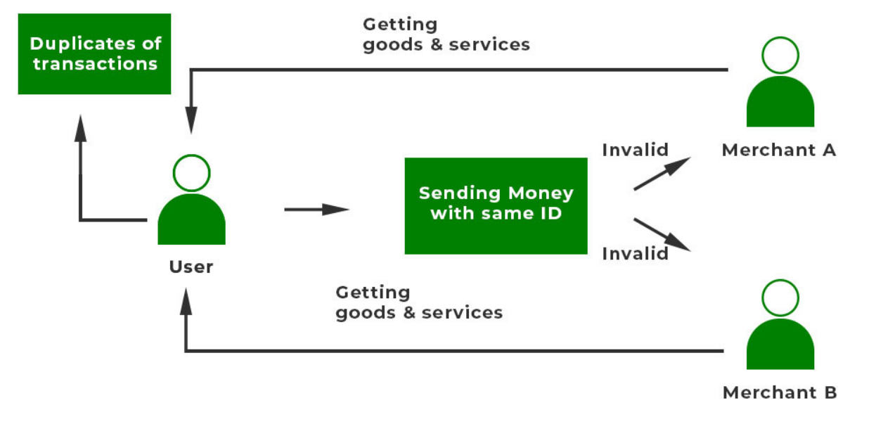

Slide 4
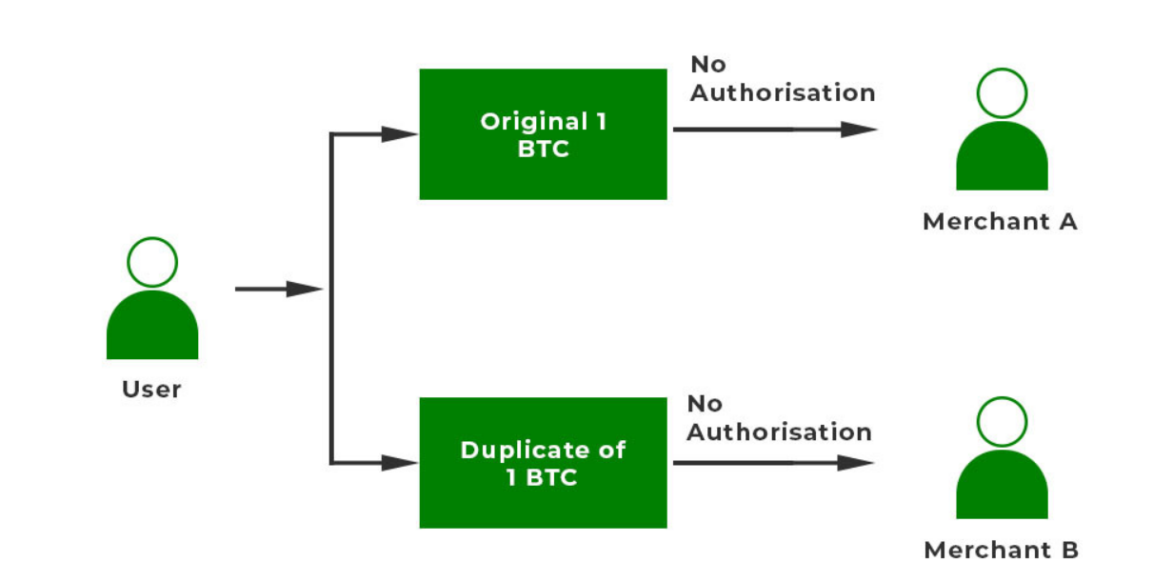
Example: Suppose a user has 1 BTC. He/She wants to avail of services from merchant A and merchant B. The user creates multiple copies of the same BTC and stores it. The user first sends the original BTC to Merchant A and gets the service. Simultaneously, the user sends the copied version of 1 BTC to Merchant B. Since the second transaction was not confirmed by other miners, the merchant accepts the bitcoin and sends the service. But the cryptocurrency that was sent is invalid. This is the case of Double Spending.

Slide 5
Let us discuss a detailed example of how bitcoin handles double-spending.
A user wants to spend 2 BTC. He/She can create multiple copies of the same cryptocurrency.
The user can send the same cryptocurrency to two different addresses say ‘Bob’ and ‘Alice’.
Both of these transactions are sent to the pool of unconfirmed transactions.

Slide 6
The first transaction T1 would be approved via the confirmation mechanism.
The confirmation mechanism states that a minimum of six confirmations by miners should be done for block validation. The block is added to the network.
However, the second transaction T2 didn’t get sufficient confirmation so it would be recognized as invalid by the confirmation process. The block with the highest number of confirmations is accepted and the other one is rejected. So transaction T1 is valid, and Alice received the bitcoin.

Slide 7
How to Combat Double Spending?
Double spending has been minimized to a large extent as companies are using many security features. But we as users also have some responsibility so that such attacks don’t happen.
Any user should wait for a minimum of six confirmations of the transaction before performing another transaction. In the blockchain, more the confirmations by different users, lesser will be double spending attacks.

Slide 8
Users should keep their hardware resources safe so that hackers do not misuse them for their own purposes. Often hackers target the hardware part because the hardware is costly. If they somehow steal the hardware, they can roll back any transaction or alter information.
Users should delete spam mails and avoid phishing to avoid unnecessary malware attacks Phishing is a very common attack by hackers as hackers target login credentials.
Software should be updated regularly with the latest antivirus installed. If the software is not up to date then the bugs present can cause major damage.

Slide 9
Hashing in Blockchain
Hashing is the process of converting an input (or 'message') into a fixed-size string of bytes.
The hash value is quickly computed.
Even a tiny change in the input will produce a significantly different hash.

Slide 10
Each block in a blockchain has a unique hash, which is created from the data within the block. This hash serves as a digital fingerprint of the block.
Each block contains the hash of the previous block, creating a chain of blocks. This ensures the integrity of the blockchain, as altering one block would change its hash, thereby breaking the chain.
Common Hashing Algorithms in Blockchain is SHA-256 which is used by Bitcoin and many other blockchain systems. It produces a 256-bit hash.

Slide 11
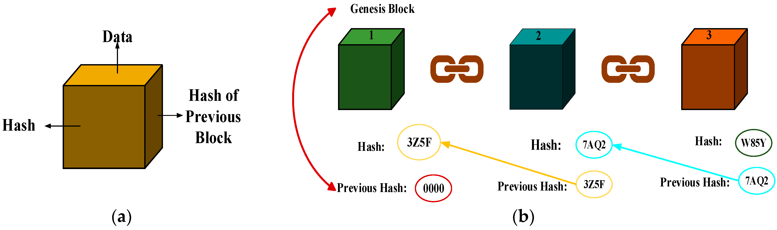

Slide 12
The size of the hash will depend on the hash function utilized, but the output using a particular hashing algorithm will be of a specific size.
Example: When you take a YouTube video of say 50 megabytes and hash it using SHA-256, the output will be a hash of 256-bits in length. Similarly, if you take a text message of 5 kilobytes, the output hash will still be 256-bits.

Slide 13
Characteristics of cryptographic hash functions
Deterministic
A hash function needs to have a fixed or specific output. What this means is that it doesn’t matter what number of times you process a given input using a hash function; the result is always of the same length. The hashes will be random and of different patterns, but the same size/length.

Slide 14
Quick Computation
In blockchain technology, a good hash function would be one that performs quick computations for every data input. It may be difficult to find the input data for a hash, but computing or calculating the hash should be ideally very fast. For instance, you can have the hash result of a simple “hi” within a fraction of a second. Similarly, the hash of a very large file will be received within a fraction of a second.

Slide 15
Different hashes for every input (Randomized) Hash functions produce different outputs for every input, even if the input data differs by only a digit or letter. For instance, the hash of the word “Alpha” should be completely different from the hash of the word “Alpha1”.
Collision resistant
Cryptographic hash functions are also supposed to have collision resistant properties. Collisions can occur in cases where a hash function gives similar outputs for different inputs. For example, if “pic1” is photo and “pic2” is a video, but a hash function produces the same output, then we call that a collision. Normally, this should not happen.

Slide 16
Pre-image resistance
One of the important properties of secure cryptographic hash functions is they are one-way. Let’s take it this way: given a hash of a particular transaction, it should be virtually impossible or practically infeasible to determine the original input data using this output.

Slide 17
Types Of Double Spending Attacks
There are different types of Double Spending attacks:
Finney Attack:
A Finney attack is a type of double-spending attack in blockchain systems which exploits the time gap between when a transaction is created and when it is broadcasted to the blockchain network.

Slide 18
Scenario
Attacker named Alice owns one Bitcoin
Alice has the power to mine blocks in the Bitcoin network
Merchant Bob sells expensive electronic
Alice sends 1 Bitcoin (BTC) to herself
Alice starts mining and successfully mines a new block
This transaction is valid, but Alice doesn’t broadcast it to the Bitcoin network yet
She keeps this block secret

Slide 19
Alice then goes to Bob's electronics store and buys a laptop for 1 BTC
She gives Bob a new transaction
Bob checks the transaction and sees that it's valid but not fully confirmed yet
Bob trusts Alice and agrees to give her the laptop before the transaction is fully confirmed by the network.
After getting the laptop, Alice quickly broadcasts the secret block she mined earlier, which contains the first transaction
Alice gets the laptop for free because Bob's transaction is now canceled

Slide 20
Race attack: is an attack in which there is a ‘race’ between two transactions.
The attacker sends the same money using different machines to two different merchants. The merchants send their goods but transactions get invalid.

Slide 21
Alice creates two transactions using the same Bitcoin:
Transaction A: Alice sends 1 BTC to Bob to pay for an item.
Transaction B: At the same time, Alice creates another transaction where she sends the same 1 BTC back to herself.
Alice broadcasts Transaction 1 to Bob and the nearby nodes in the Bitcoin network
She broadcasts Transaction 2 to other parts of the network

Slide 22
If Transaction 1 gets confirmed first, Alice loses 1 BTC, and Bob gets paid.
If Transaction 2 gets confirmed first, Bob’s transaction becomes invalid, and Alice keeps her 1 BTC while still receiving the laptop.
The success of the race attack depends on the speed at which the conflicting transactions are broadcast.
Alice ensures that Transaction 2 is more likely to be confirmed first.

Slide 23
51% Attack: This type of attack is prevalent in small blockchains. Hackers usually take over 51% of the mining power of blockchain and therefore can do anything of their own will.
If Alice has more than 50% of the network's mining power, she can manipulate the blockchain to her advantage.

Slide 24
Blockchain Mining
Blockchain mining is a process to validate every step in the transactions while operating bitcoins or other cryptocurrencies. The people involved here are known as blockchain miners
The process is rewarding, as well. A single user does not handle the mining process, but a number of them compete on a unified authentication to get the rewards. Each mining success comes with a bonus of several bitcoins.

Slide 25
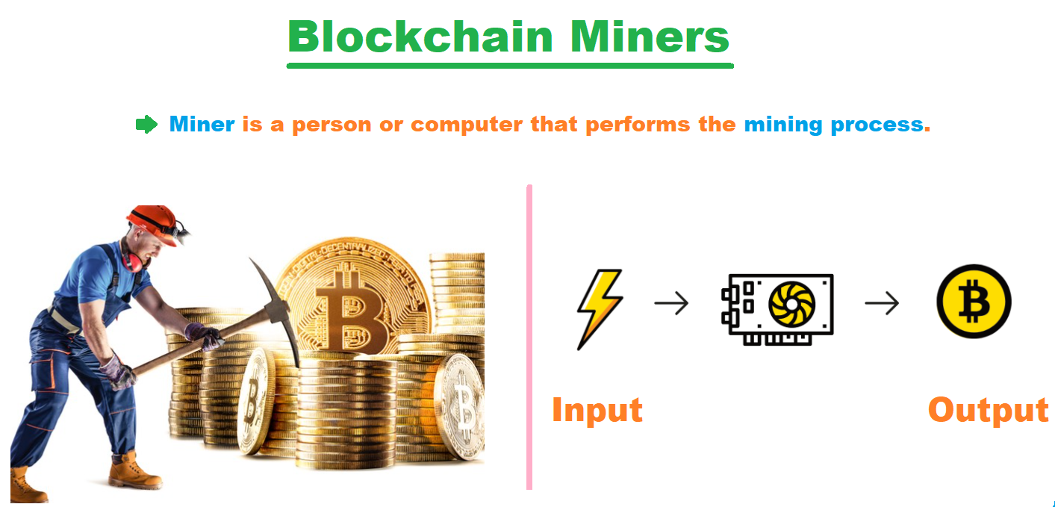

Slide 26
Scenario 1:
Imagine a classroom where students are playing a game. The teacher writes math problems on the board, and the first student to solve each problem gets a piece of candy. The classroom represents the blockchain network, the teacher's math problems are the puzzles to be solved, and the pieces of candy are the cryptocurrency rewards.
Here's how blockchain mining works with this analogy:
Pending Transactions: Let's say the students in the class have been making promises to each other: "I'll give you my toy if you give me your book." These promises are like pending transactions in the blockchain.
Math Problem: The teacher (the blockchain system) writes a difficult math problem on the board. This is the puzzle that needs to be solved to verify and add the transactions to the blockchain.
Solving the Problem: All the students (miners) start working on solving the math problem. It’s a hard problem, so it takes some time.

Slide 27
First to Solve: One student solves the problem first and shows the answer to the teacher. This student is like the miner who solves the puzzle first.
Verification: The teacher checks the answer quickly. If it’s correct, the student is allowed to write the promises (transactions) on the class notebook (blockchain ledger) and everyone updates their own notebooks.
Reward: The student who solved the problem gets a piece of candy (cryptocurrency) as a reward.
Security: If a student tries to cheat and write fake promises in the notebook, other students will notice because they all have copies of the notebook and can see the changes don’t match.

Slide 28
How Blockchain mining works
All the pending transactions are collected in a pool.
Miners (special computers) compete to solve a mathematical puzzle. The puzzle is difficult to solve but easy for others to verify. Think of it like a sudoku that takes hours to solve but seconds to check.
The first miner to solve the puzzle gets to add a block of transactions to the ledger. This block contains the solved puzzle, the transactions, and a reference to the previous block in the chain (hence the name blockchain).

Slide 29
The miner is rewarded with some cryptocurrency for their effort. This is how new coins are created and distributed.
Other miners and participants in the network quickly check the solution. If it’s correct, the block is added to everyone’s copy of the ledger.
This process is secure because solving the puzzle requires a lot of computational power, making it difficult for anyone to tamper with the transactions.

Slide 30
Note:
The miner who solves the puzzle in blockchain mining does not perform the transactions themselves. Instead, the miner who solves the puzzle is responsible for validating and adding a block of transactions to the blockchain.
Users of the blockchain network create transactions. For example, Alice sends 1 Bitcoin to Bob. This transaction is broadcast to the network and placed in a pool of unconfirmed transactions.

Slide 31
Miners collect a batch of these unconfirmed transactions from the pool and form a block.
Miners compete to solve a complex mathematical puzzle. The first miner to solve the puzzle gets the right to add their block of transactions to the blockchain.

Slide 32
Why would you mine Blockchain?
You can earn money by mining Blockchain; the amount you will earn depends on your mining capacity. In the mining mechanism in blockchain, mining needs certain resources like a cooling system, electricity, computational hardware, and maintenance. The more robust your mining setup is, the higher would be your mining capacity. Consequently, you can make more money. You get paid for mining because mining is significant for Blockchain to maintain integrity.

Slide 33
Types of Mining
1. Individual Mining
In Individual Mining, the user has to register itself as a miner. As soon as a transaction occurs, all the single users in the blockchain network will receive a mathematical problem. The first one to solve the complex mathematical problem gets rewarded. The solution comes after rigorously using the hardware and software properties of the computer, which is being used by the miner.

Slide 34
Pool Mining
Another type of mining is Pool Mining, where several users operate together to approve the transaction. Numerous transactions occur every second. Then the entire team of miners in the network operate together to solve the complex numerical and computational problem. After the result is validated, the reward is then also split between all users.

Slide 35
Cloud mining
Cloud mining involves renting mining power from a provider who owns and operates the mining hardware. Users pay for a contract and receive a portion of the mined cryptocurrency.

Slide 36
Use of Blockchain Mining
1. Validating Transactions
Bitcoins are decentralized digital currencies, which are managed on a peer-to-peer computer network and transferred from one user to another. Bitcoin transactions occur in huge figures daily. But there is a certain lag in the entire framework.
Since these cryptocurrencies operate without a central administrator, there is a substantial amount of insecurity with the transactions that transpire. While dealing with printed currency, the validation lies in the printed numerical codes in each of them. Accordingly, what is the authentication with such cryptocurrencies?
With each transaction, blocks are added to the blockchain. The validation lies in the mining results from the blockchain miners.

Slide 37
Confirming Transactions
Miners work in the blockchain mining process to confirm whether the transaction is authentic or not. Transactions get confirmed on completing the inclusion in the block.
Securing Network
Bitcoin Miners work together to secure the transaction network. Network security increases with the increase in the operators mining the blockchain.

Slide 38
Algorithms for Blockchain mining:
Two prominent algorithms used for Blockchain mining are proof-of-work and proof of stake.
PoW is like a race where miners compete to solve a puzzle. The first one to solve it gets to add a block of transactions to the blockchain and earns a reward.
Example: Bitcoin uses PoW. Miners compete to solve puzzles. The first miner to solve it broadcasts the solution, and if verified by others, the block is added to the blockchain, and the miner gets bitcoins as a reward.
PoW requires a lot of electricity because miners need powerful computers to solve puzzles quickly.

Slide 39
PoS is like a lottery where the more cryptocurrency (like coins) you have, the more likely you are to win the right to add the next block of transactions to the blockchain.
Example: Ethereum 2.0 is transitioning to PoS. Validators are selected based on the amount of Ether (ETH) they hold and are willing to stake. Chosen validators validate transactions and create new blocks, earning ETH rewards in return.
PoS is more energy-efficient compared to PoW because it doesn't require intensive computations to solve puzzles.

Slide 40
Blockchain - Merkle Tree
A Merkle tree (also known as a hash tree) is a fundamental data structure used in computer science and cryptography. It's particularly important in blockchain technology for efficient and secure verification of large sets of data.

Slide 41
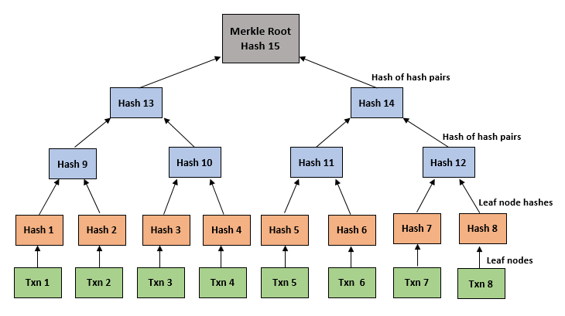
Structure of Merkle tree

Slide 42
The tree is constructed from the bottom up, starting with individual pieces of data known as "leaves“. Each leaf node is associated with a cryptographic hash of a data block.
Pairs of leaf nodes are combined to compute a hash of their combined values. This process continues until there is only one hash, known as the "root hash" or "Merkle root," at the top of the tree. The root hash is a cryptographic hash that uniquely represents all the data in the tree.

Slide 43
Suppose we have a blockchain with a block containing 4 transactions:
Transaction A
Transaction B
Transaction C
Transaction D
Each transaction (A, B, C, D) is hashed individually. Let's denote these hashes as H(A), H(B), H(C), and H(D).

Slide 44
Pair transactions and hash their concatenated hashes:
Pair H(A) and H(B), compute H(AB) = hash(H(A) + H(B))
Pair H(C) and H(D), compute H(CD) = hash(H(C) + H(D))
Root Hash = hash(H(AB) + H(CD))

Slide 45
Block Header
In a blockchain, a block header is like an ID card for each block of transactions. It contains important information that makes sure everything in the blockchain works smoothly and securely.

Slide 46
Components of a Block Header:
Version Number: This indicates the version of the blockchain protocol being used.
Previous Block Hash: This is the cryptographic hash of the header of the previous block in the blockchain. It links the current block to its predecessor, creating the chain of blocks.
Merkle Root: The Merkle root is the root hash of the Merkle tree

Slide 47
Timestamp: The timestamp records the exact time when the block was created or mined. It helps in maintaining the chronological order of blocks in the blockchain.
Difficulty Target: This field specifies the difficulty level that the block's proof-of-work must meet.
Nonce: The nonce is a 32-bit (or larger) field used in proof-of-work algorithms. Miners change the nonce value repeatedly to find a hash value that meets the difficulty target.

Slide 48
{
"version": 1,
"previousBlockHash": "00000000000000000014cde3a62f24e8f7ee562f0fe8d1bfa1e36d7c69b17a21",
"merkleRoot": "c7f7a1c5d3feadfa4e5c632c899d7b9c9e5321c8a4467c9146e7b153e7a612ce",
"timestamp": 1630850492,
"difficultyTarget": 120330,
"nonce": 1984710036
}

Slide 49
Payment verification- Merkle tree benefits
The Merkle tree helps you quickly find and verify transactions by using hashes in a hierarchical way.

Slide 50
Scenario:
You want to check if a payment you received in the past was actually recorded on the blockchain. However, you only have a simplified version of the blockchain on your computer that includes just the headers of each block.

Slide 51
Find the Time of the Payment:
Figure out roughly when the payment was made. This helps narrow down where to look in the blockchain.
Look Back in Your Blockchain:
Start from the most recent block (the latest transactions) and go backwards.
Check each block's timestamp until you find one that might include the payment transaction.
Find the Right Block:
When you find a block that matches the timeframe of the payment, check inside it to see if it contains the specific transaction you're interested in.

Slide 52
Request the Merkle Tree:
Once you find the block that likely contains the payment transaction, ask your blockchain software to show you the Merkle tree for that block.
Locate Your Payment:
In the Merkle tree, find the transaction that matches the details of the payment you received. Each transaction is represented by a hash (a unique identifier).

Slide 53
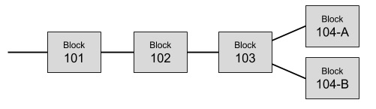
Resolving Conflicts
As we have seen the Bitcoin network contains several miners. It is possible, that the two different miners solve the Proof-of-Work at the same time and thus add their blocks to the last known block in the chain. This is illustrated in below image −

Slide 54
The Bitcoin blockchain is currently at Block 103, and miners are competing to find the next valid block (Block 104).
Miner A and Miner B are both actively mining Block 104. They are trying to solve the Proof-of-Work puzzle, which involves finding a hash value that meets the network's difficulty target.
Miner A and Miner B both find a valid solution to the PoW puzzle at almost the same time.
Let's say, Miner A finds Block 104a with its own set of transactions and broadcasts it to the network. Miner B finds Block 104b with a different set of transactions and also broadcasts it to the network.
Nodes in the Bitcoin network receive both Block 104a and Block 104b almost simultaneously. Some nodes might receive Block 104a first, while others might receive Block 104b first due to network latency.

Slide 55
Miners and nodes in the network continue to mine and add new blocks to either Chain 1 or Chain 2, based on their received blocks.
The Bitcoin protocol dictates that nodes always follow the longest valid chain, which is the chain with the most accumulated Proof-of-Work.
As more miners continue to mine subsequent blocks One of the chains (let's say Chain 1) will eventually have more blocks added to it, making it the longest chain.
Nodes on the network will abandon the shorter chain (Chain 2 in this case) and adopt Chain 1 as the valid blockchain.

Slide 56
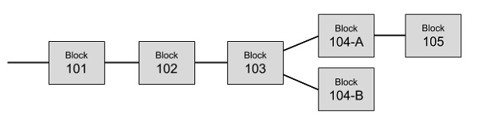
So the Block 104-B has to be purged. This is how the conflicts are resolved and only one single chain of blocks is maintained by the system

Slide 57
Block chain privacy
As the ledger which is recording all the bitcoin transactions is made truly public, the privacy is at stake. Anybody in the world would be able to know who paid whom? The traditional banking system is able to maintain this kind of privacy by keeping its records confidential.
Privacy in Bitcoin system is achieved by a different strategy. Note that we said that the sender of a bitcoin needs to know whom to pay. So he asks for the public key of the vendor to which he desires to make the payment. This public key can be anonymous.

Slide 58
In the sense, as a vendor of some services, when somebody asks you where to send the payment, you would simply send him your public key. The association of this public key with you is not recorded anywhere in the ledger. That way anybody outside of this transaction would only know how much money is transacted and to which public key the money is paid out.
To achieve a higher degree of privacy, for every transaction, you may generate a new private/public key for each transaction so that multiple transactions made by you cannot be grouped together by a third party. For an outsider, this would simply mean that multiple transactions of smaller values were made and they will never will be linked to a common source.

Slide 59
Scenario
Alice wants to receive Bitcoin from Bob for a service she provided. She generates a pair of keys:
Public Key (Address): 𝐴_{𝑝𝑢𝑏}​
Private Key: 𝐴_{𝑝𝑟𝑖𝑣}
Alice provides Bob with her public key 𝐴_{𝑝𝑢𝑏}​ ​. This is where Bob will send the Bitcoin.
Bob initiates a transaction to Alice's public address 𝐴_{𝑝𝑢𝑏}​ with the specified amount of Bitcoin.
The transaction details are recorded on the blockchain
Sender: Bob's address
Receiver: Alice's public address 𝐴_{𝑝𝑢𝑏}​
Amount: X BTC
Transaction ID: 𝑇𝑋𝐼𝐷

Slide 60
On the blockchain, anyone can see that a transaction occurred from Bob to Alice for amount X BTC. They can also see the transaction ID 𝑇𝑋𝐼𝐷.
Alice's identity is protected because only her public key or address 𝐴_{𝑝𝑢𝑏}​ ​ is visible on the blockchain. Her real-world identity is not explicitly tied to 𝐴_{𝑝𝑢𝑏}​ ​ .
To enhance privacy further, Alice can generate a new pair of keys for each transaction
For another transaction, she uses a different public key 𝐴_{𝑝𝑢𝑏’}​ ​ and its corresponding private key 𝐴_{𝑝𝑟𝑖𝑣’}.
This way, transactions are less likely to be linked to the same owner, enhancing privacy even if someone observes multiple transactions involving Alice.

